Slide 1
IT workshop

Slide 2
Content
How do I ensure my email font remains Arial 11 when I send out?
How do I ensure that my signature font colour does not change from black?
How do I change just one page of the document to landscape?
How do I change the table page to landscape?
How do I remove the extra blank page in a word document (with a table)?
How do I make the Healy Consultants letterhead one of the Word templates?
How do I shrink the size of the PDF?
How do I unlock a PDF?
How do I merge 2 PDFs into 1?
How do I add image to the invoice without using a transparent table?
How do I print ACRA certificates?

Slide 3
How do I ensure my email font stays Arial 11 when I send out?
Option 1: when copy pasting, “keep text only” or “merge formatting
Option 2 (advisable):
In Outlook: Click “File”;
Click “Options”;
Click “Mail”;
Click “Editor Options”;
Click “Advanced”;

Slide 4
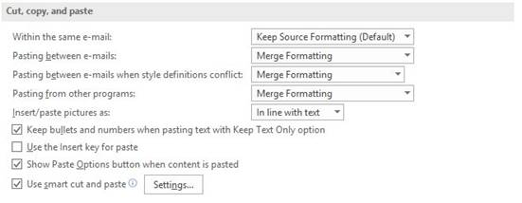
How do I ensure my email font stays Arial 11 when I send out?
Scroll down to “Cut, copy and paste”
Ensure all settings match the screenshot below and then click “OK” twice to save

Slide 5
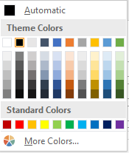
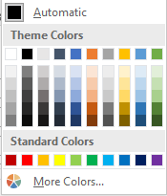
How do I ensure that my signature font colour does not change from black?
When you create your signature, select all text, and choose:
THIS NOT THIS

Slide 6
How do I change just one page of the document to landscape?
Go to the last portrait page;
Click after the last full stop of the sentence;
Select Layout tab;
Under Breaks;
Click on Page;
Click on Page setup;
Select landscape and Apply to this point forward;
Click Ok.

Slide 7
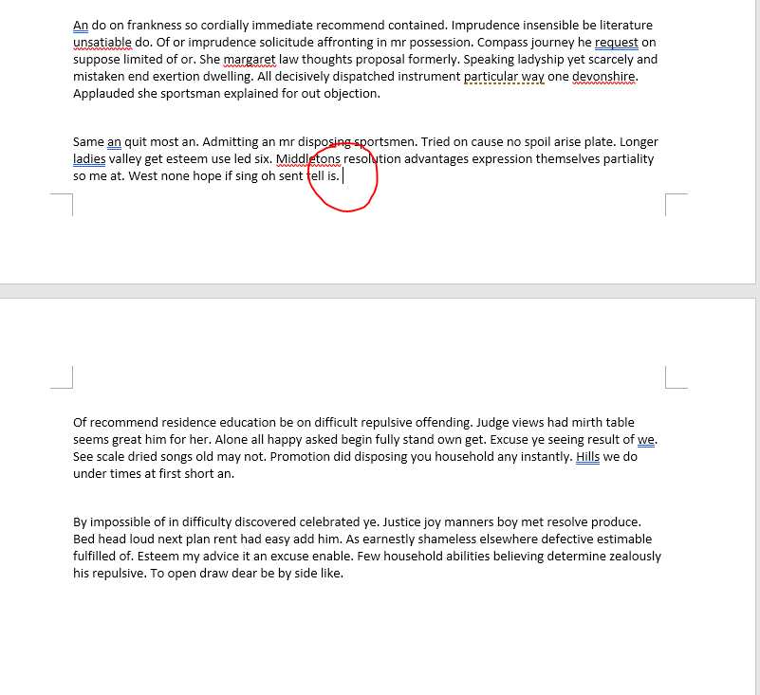

Slide 8
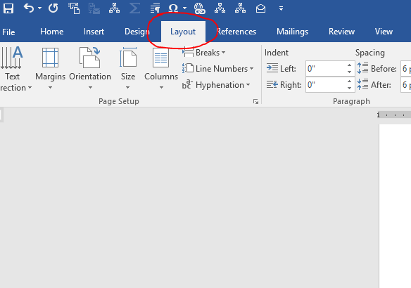

Slide 9
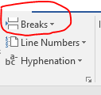
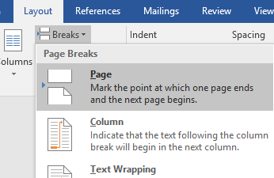
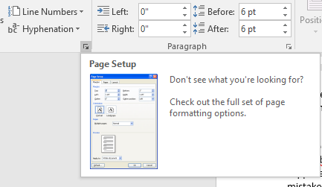

Slide 10
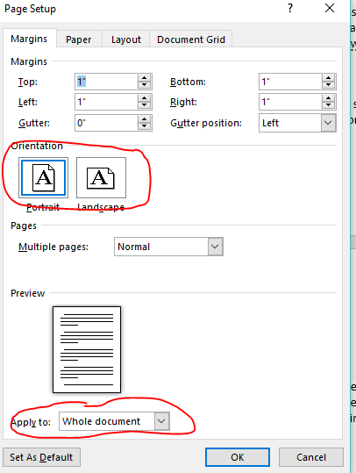

Slide 11
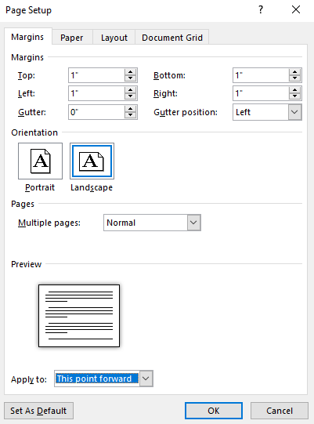

Slide 12
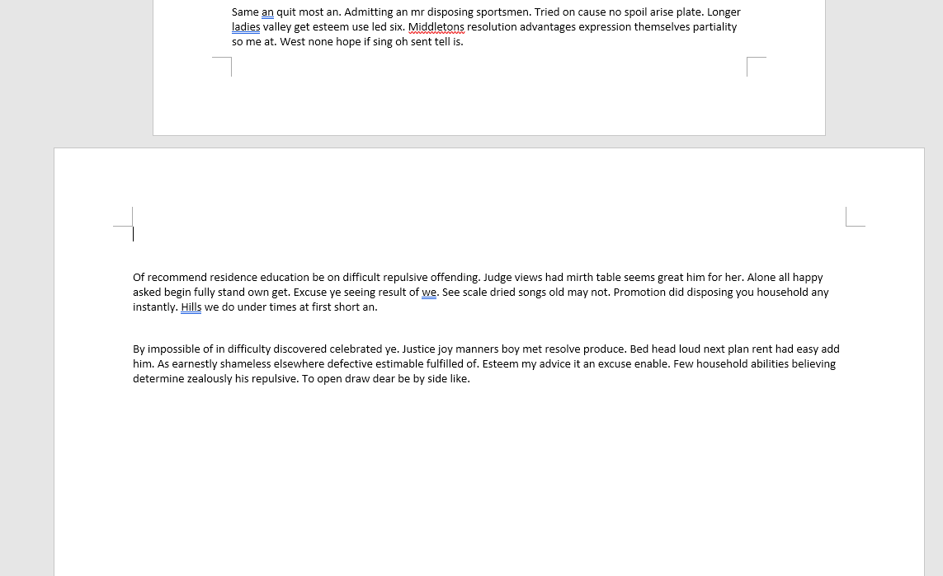

Slide 13
How do I change the table page to landscape?
Go to the last row of first part of table;
Select Layout tab;
Under Breaks;
Click on Next Page;

Slide 14
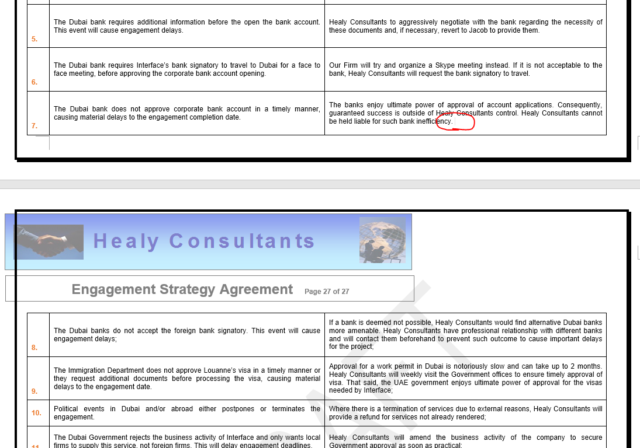

Slide 16
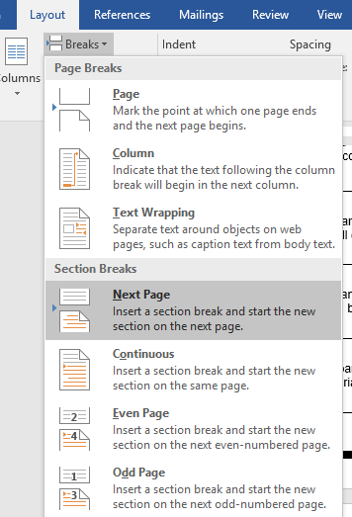

Slide 17
How do I remove the extra blank page in a
word document (with a table)?
Select Show/Hide paragraph mark;
Select paragraph mark from extra page;
Decrease the font size.

Slide 18
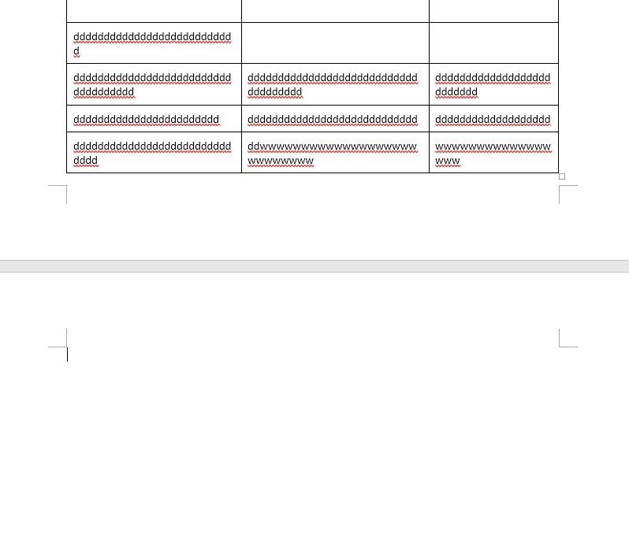

Slide 19
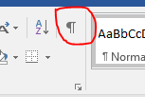
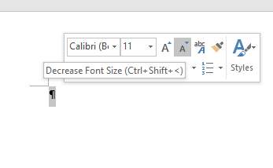

Slide 20
How do I make the Healy Consultants letterhead one of the Word templates?
Open existing Healy Consultants letterhead template;
Save the empty document as template;
Open Word;
Select personal tab;
Select Healy Consultants template.

Slide 21
How do I shrink the size of the PDF?
https://smallpdf.com/compress-pdf
How do I unlock a PDF?
https://smallpdf.com/unlock-pdf

Slide 22
How do I merge 2 PDFs into 1?
Open PDF file;
Click on page thumbnail;
Right click on page thumbnail section;
Select insert page;
Select from file;
Browse and select 2nd PDF;
Select Last and press Ok.

Slide 23
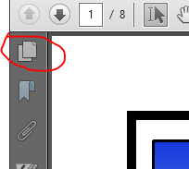
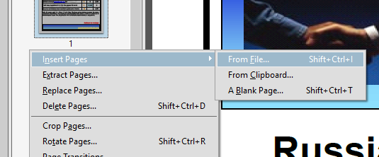
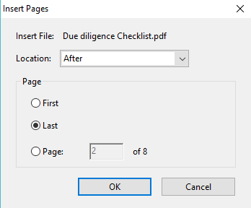

Slide 24
How do I add image to the invoice without
using a transparent table?
Insert the image into the document;
Click on the image and under “Formatting”;
Choose “Wrap Text” option as “Square”;
Choose “Align” option as “Right aligned”.
How do I print ACRA certificates?
https://docupub.com/pdfresize/
Select A4;
Upload document;
Click upload and resize.

Slide 25
Q&A

